Slide 1

Discover your degree
Start your career
Expand your opportunities
LIVE, LEARN AND
WORK ABROAD
In our US university network

Slide 2
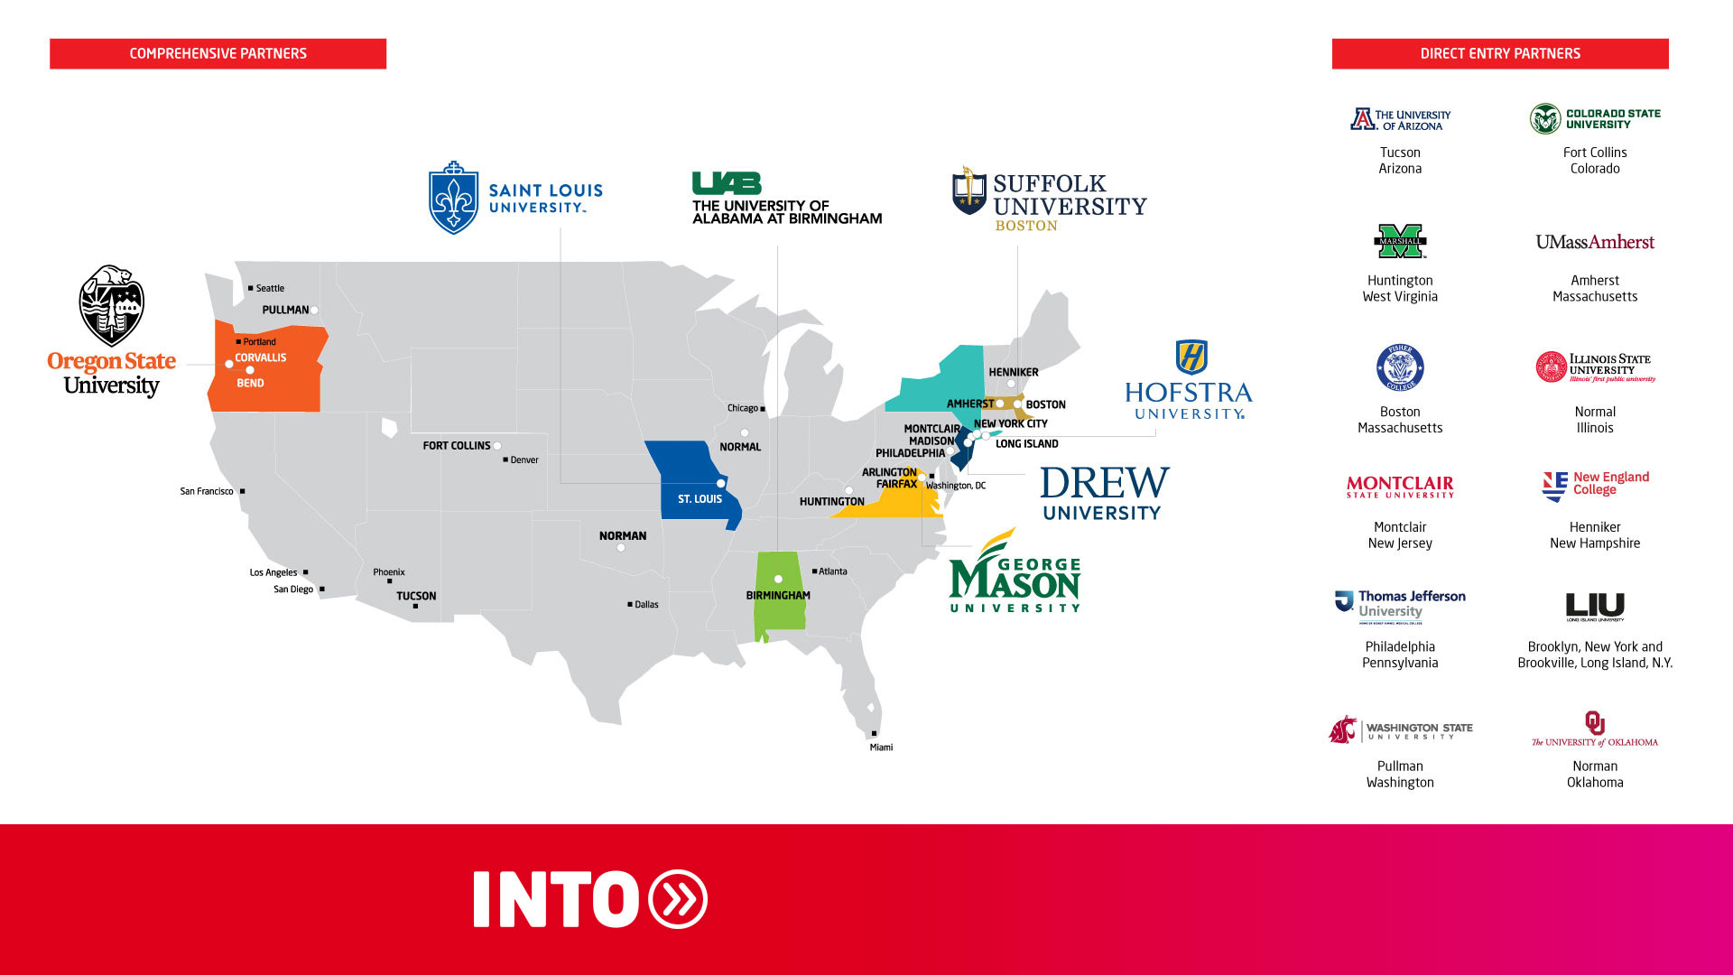
PARTNER LOCATIONS

Slide 3

World-class universities
with outstanding research reputation.
Internationally recognized
qualiﬁcations.
WHY
study in the
US?
Shorter programs mean
reduced spending.
Great career development prospects through strong industry connections and focus on employability.
Start your career in the US with OPT: With Optional Practical Training (OPT) you can work for one year after you graduate from your program.
With the STEM OPT extension, you can work in the US for up to three years.

Slide 4

FLEXIBILITY
CHOICE
PERSONAL
DEVELOPMENT
SUPPORT
WORLD-LEADING ACADEMICS
POST-STUDY
WORK
ENCOURAGING
SPECIALIZED
WORK AND
STUDY

Slide 5

14,000 STUDENTS
From 150 countries and territories around the world choose INTO each year
94%
GLOBAL STUDENT SATISFACTION
INTO Student Experience Survey 2021
Programs designed for international student
success at leading US universities
Wide range of undergraduate and graduate programs
English preparation and engagement in US university life
Personalized expert teaching and first-class facilities
Pre-arrival, accommodation and study support
WHY STUDY WITH OUR US UNIVERSITY PARTNERS?
Culturally diverse and welcoming social environment

Slide 6

PUBLIC Universities
“Looking back, I could not even imagine that I would find a spot in this highly competitive career market. However, the skills I gathered throughout my path at George Mason University helped me not only be competitive but also become one of the rising stars.”
Sofya, Russia
BS, Tourism and Events Management Marketing Director at Mason Dining - Sodexo

Slide 7


THE WEST COAST’S
MOST VALUABLE
DEGREE
Oregon State University is an international public research university that draws people from all 50 states and more than 100 countries.
The world's biggest challenges are the focus of our research. Our discoveries and inventions have made impacts on the future of technology and everyday life.

Slide 8

Why Oregon State University?
Oregon State University graduates earn
$20,000+ more per year than the average salary of graduates from US schools
U.S. Department of Education College Scorecard 2023
Top 20% Best Paid Graduates in the US PayScale Salary Report 2021
Top 1.4% Global University
Center for World University Rankings 2023
540+ current students in OPT with
66% employed on the West Coast
University Data 2022
TOP PROGRAMS
MECHANICAL ENGINEERING
ELECTRICAL AND COMPUTER ENGINEERING
COMPUTER SCIENCE
BUSINESS ANALYTICS
ROBOTICS
ENVIRONMENTAL SCIENCE

Slide 9

#59
MOST INNOVATIVE SCHOOL IN THE US
U.S. News &
World Report
2023 RANKINGS
#58
Electrical/Electronic/ Communications Engineering Program
#54
INDUSTRIAL ENGINEERING
PROGRAM
#65
Computer Science
Program
#36
CIVIL ENGINEERING
PROGRAM
#69
Best Engineering
Schools

Slide 10


YOUR DESTINATION
FOR HEALTH AND INNOVATION
As a growing travel destination in the US, Birmingham has a rising food scene paired with greenery in our vibrant downtown district. The university hosts a highly ranked academic hospital for top-of-the-line medical research breakthroughs.
The city's business community and the university come together to inform our top-ranked entrepreneurship program. With a booming start-up sector in town, explore where you career will take you in Birmingham.

Slide 11

Why The University of Alabama
at Birmingham?
Top 8% Best Global University
U.S. News & World Report 2023
100% Research Placement
for Undergraduates
Birmingham Is The No. 64 Best City
To Start A Business
WalletHub 2023
TOP PROGRAMS
BIOTECHNOLOGY
ELECTRICAL AND COMPUTER ENGINEERING
PUBLIC HEALTH
MULTIDISCIPLINARY BIOMEDICAL SCIENCES
MBA
NURSING

Slide 12
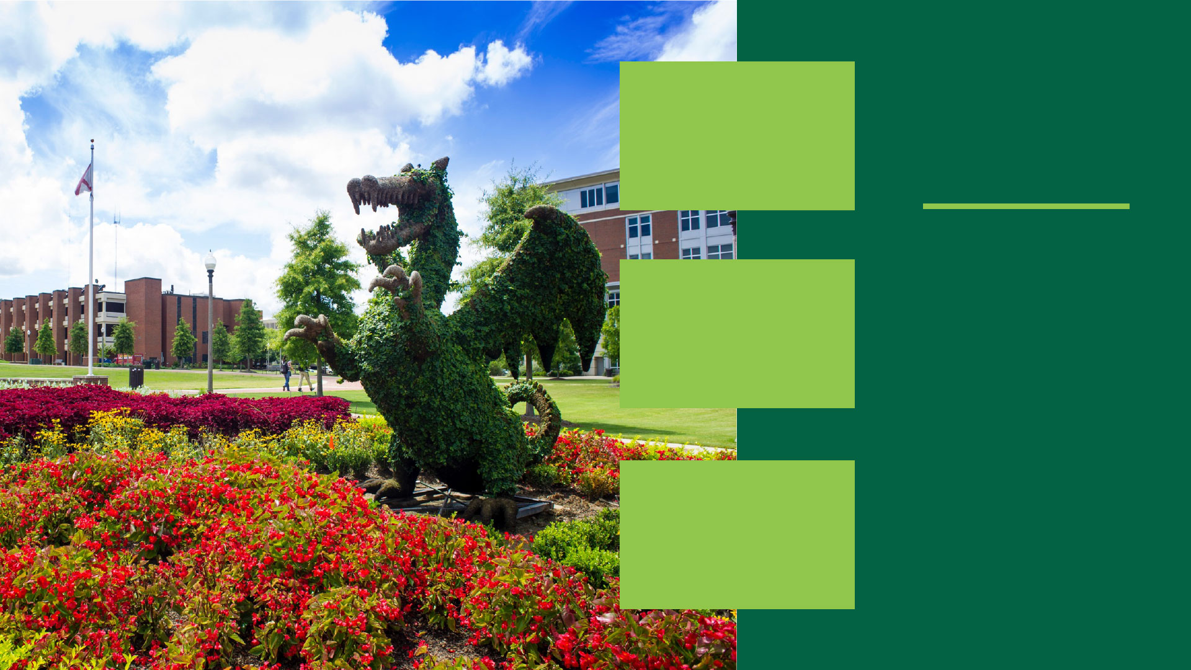
#64
TOP PUBLIC SCHOOL
U.S. News &
World Report
2023 RANKINGS
#22
Public Health
Program
#9
BACHELOR OF SCIENCE
IN NURSING
#35
Best Medical
School: Research
#1
HEALTH CARE MANAGEMENT PROGRAM

Slide 13
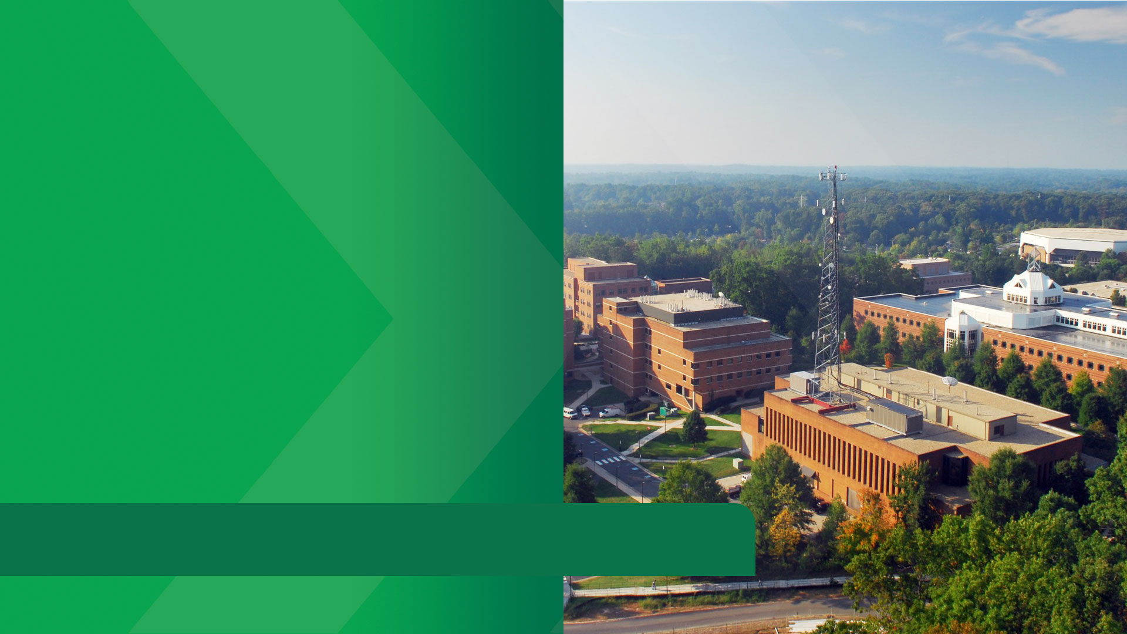

UNLOCK
WASHINGTON D.C.
CAREER CONNECTIONS
Mason offers more than 200 undergraduate, graduate degrees and numerous minors and certificate programs to customize your education and meet your career and personal goals.
Earn your degree near Washington D.C. and the Northern Virginia tech sector where Amazon HQ and tech leaders innovate the industry.

Slide 14

Why George Mason University?
#1 Young US University
Times Higher Education 2022
Cost Of Living In Northern Virginia
Is 23% Lower Than San Francisco
Nerd Wallet’s Cost of Living Calculator
Washington, DC is the No. 4 Tech
Talent Market in the US
CBRE 2023
#9 Best University for
Cybersecurity in the World
EduRank 2022
TOP PROGRAMS
COMPUTER SCIENCE
COMPUTER ENGINEERING
HEALTH INFORMATICS
BUSINESS ANALYTICS
BUSINESS
PUBLIC POLICY
PUBLIC HEALTH
DATA ANALYTICS ENGINEERING

Slide 15

#20
MOST INNOVATIVE
SCHOOL
U.S. News &
World Report
2023 RANKINGS
#34
Graduate Public Policy Analysis Program
#51
TOP PUBLIC SCHOOL
#65
Graduate Computer
Science Program
#105
NATIONAL UNIVERSITY
#84
Undergraduate
Business Program

Slide 16

MASON
KOREA
Study in two global business
hubs: students have a unique
3+1 opportunity to spend
three years a Mason Korea
and one year at Mason's main
campus in Virginia.
Mason Korea’s campus is
located in Songdo, South Korea.

Slide 17
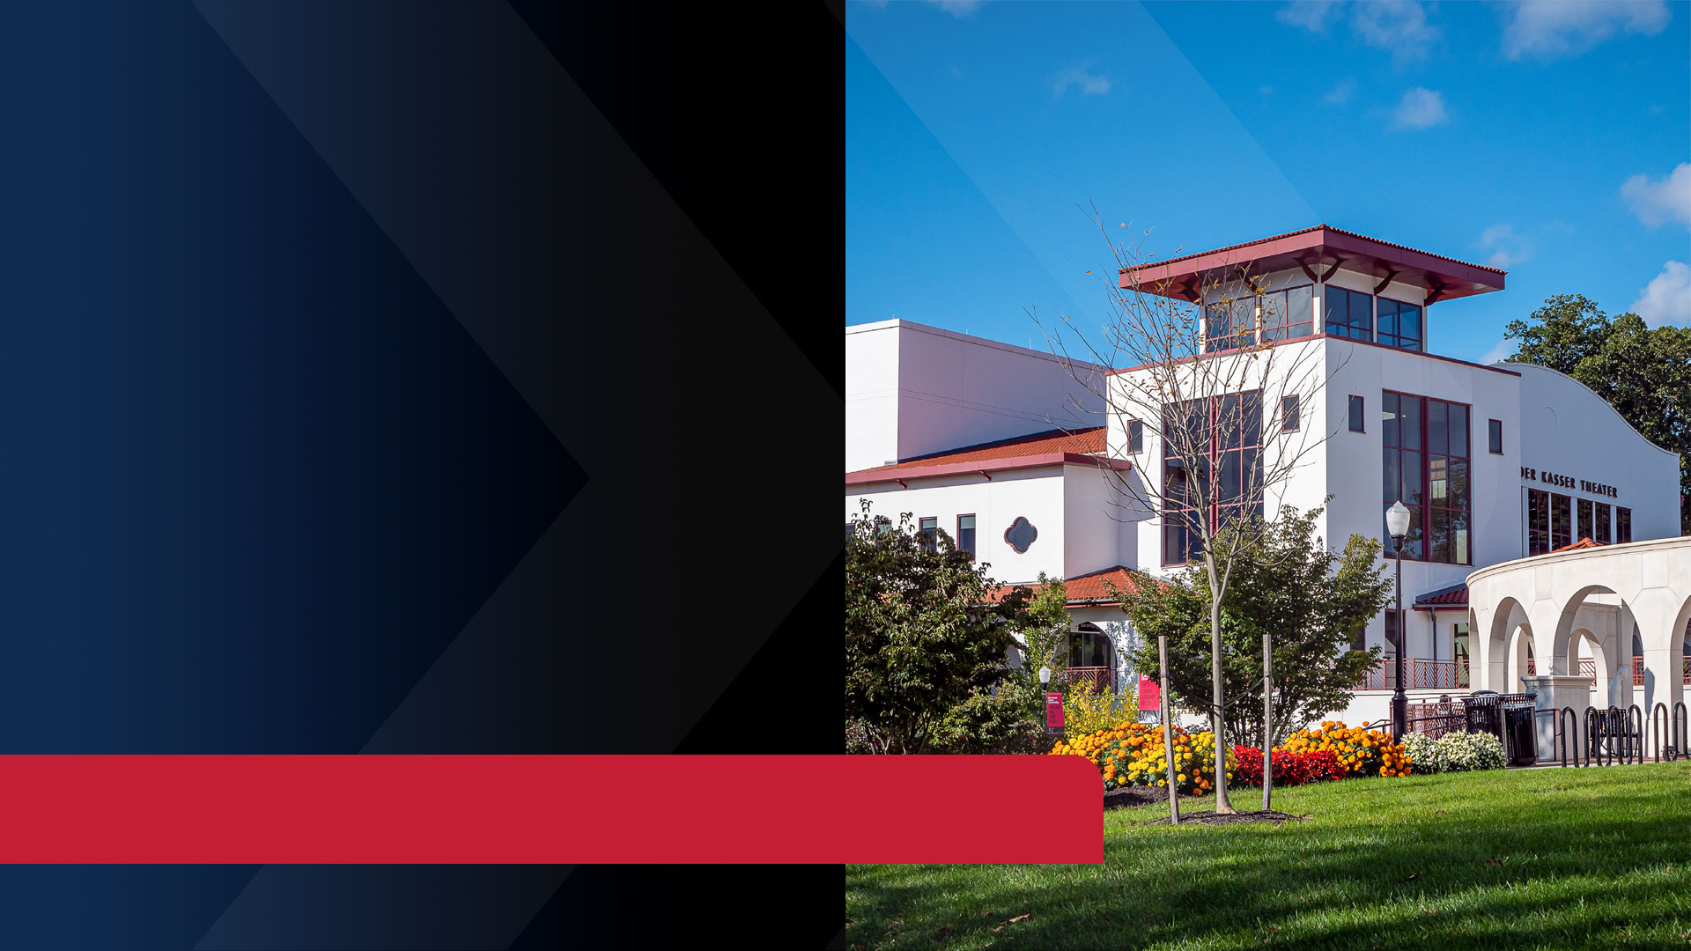

NEXT-LEVEL VALUE
NEAR NEW YORK CITY
Montclair State University is a top 100 public university located in Montclair, New Jersey.
Join a vibrant on-campus community with the convenience of university resources to enhance your studies and your overall US university experience.

Slide 18

Why Montclair State University?
Safest Campuses in America
Niche.com 2023
93% Of Graduates Are
Employed after earning their
undergraduate degree
More Than 60 Countries
Represented on Campus
TOP PROGRAMS
STEM-DESIGNATED MBA
One-year Graduate Business
Programs in STEM-DESIGNATED MBA
and BUSINESS ANALYTICS
Combined COMPUTER SCIENCE
Degree with CYBERSECURITY and
DATA ANALYTICS

Slide 19

TOP 100
PUBLIC UNIVERSITY
U.S. News & World Report 2023
TOP
RANKINGS
Listed Among Forbes’
TOP COLLEGES
OF 2022
TOP 200
IN NATIONAL UNIVERSITIES
U.S. News & World Report 2023
BEST COLLEGE
FOR YOUR MONEY
Money 2022
TOP 20%
BEST VALUE FOR
GRADUATE SCHOOLS
College Factual 2023

Slide 20


A WORLD
TOP 100 UNIVERSITY WHERE BUSINESS
MEETS TECH
Repeatedly recognized for its outstanding academic programs and exceptional value.
Arizona is where students collaborate with leading faculty to solve critical problems and make the world better through groundbreaking discovery.

Slide 21

Why University of Arizona?
#95 Top World ​University
CWUR 2023
#48 TOP US ​UNIVERSITY
CWUR 2023
Tier 1 Institution
Fifth US University in NASA-funded Activity
HERD 2021
TOP PROGRAMS
MANAGEMENT INFORMATION
SYSTEMS (MIS)
BUSINESS
COMPUTER SCIENCE
COMPUTER ENGINEERING
MECHANICAL ENGINEERING

Slide 22

2023
RANKINGS
#5
In Undergraduate ​Management Information Systems
(PUBLIC UNIVERSITIES)
U.S. News & World Report 2023
#30
IN ​UNDERGRADUATE
BUSINESS ​(PUBLIC UNIVERSITIES)
U.S. News & World Report 2023
TOP 50
PUBLIC SCHOOL
U.S. News & World Report 2023

Slide 23
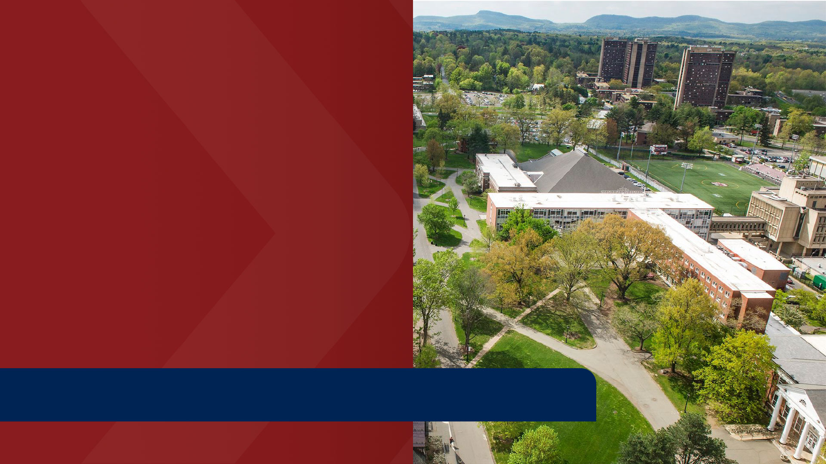

HIGH-PROFILE UNIVERSITY.
HIGH-PROFILE CAREERS.
At UMass Amherst, our revolutionary spirit drives students to explore career-making
opportunities during their graduate program studies so they can make a difference in the real world.

Slide 24

Why University of Massachusetts Amherst?
#26 Public Universities
20 Programs Ranked Among
The Top 200 Worldwide
QS World Universities by Subject 2023
#55 Best Engineering Schools
TOP GRADUATE PROGRAMS
BUSINESS ANALYTICS
MATERIALS ENGINEERING
BUSINESS
ELECTRICAL AND COMPUTER
ENGINEERING
MECHANICAL ENGINEERING

Slide 25

#1
PUBLIC UNIVERSITY
ENGINEERING PROGRAM
IN NEW ENGLAND
U.S. News &
World Report
2023 RANKINGS
TOP 50 IN CIVIL ENGINEERING
#67
NATIONAL UNIVERSITIES
#51
Business Programs
#20
MS IN BUSINESS
ANALYTICS

Slide 26
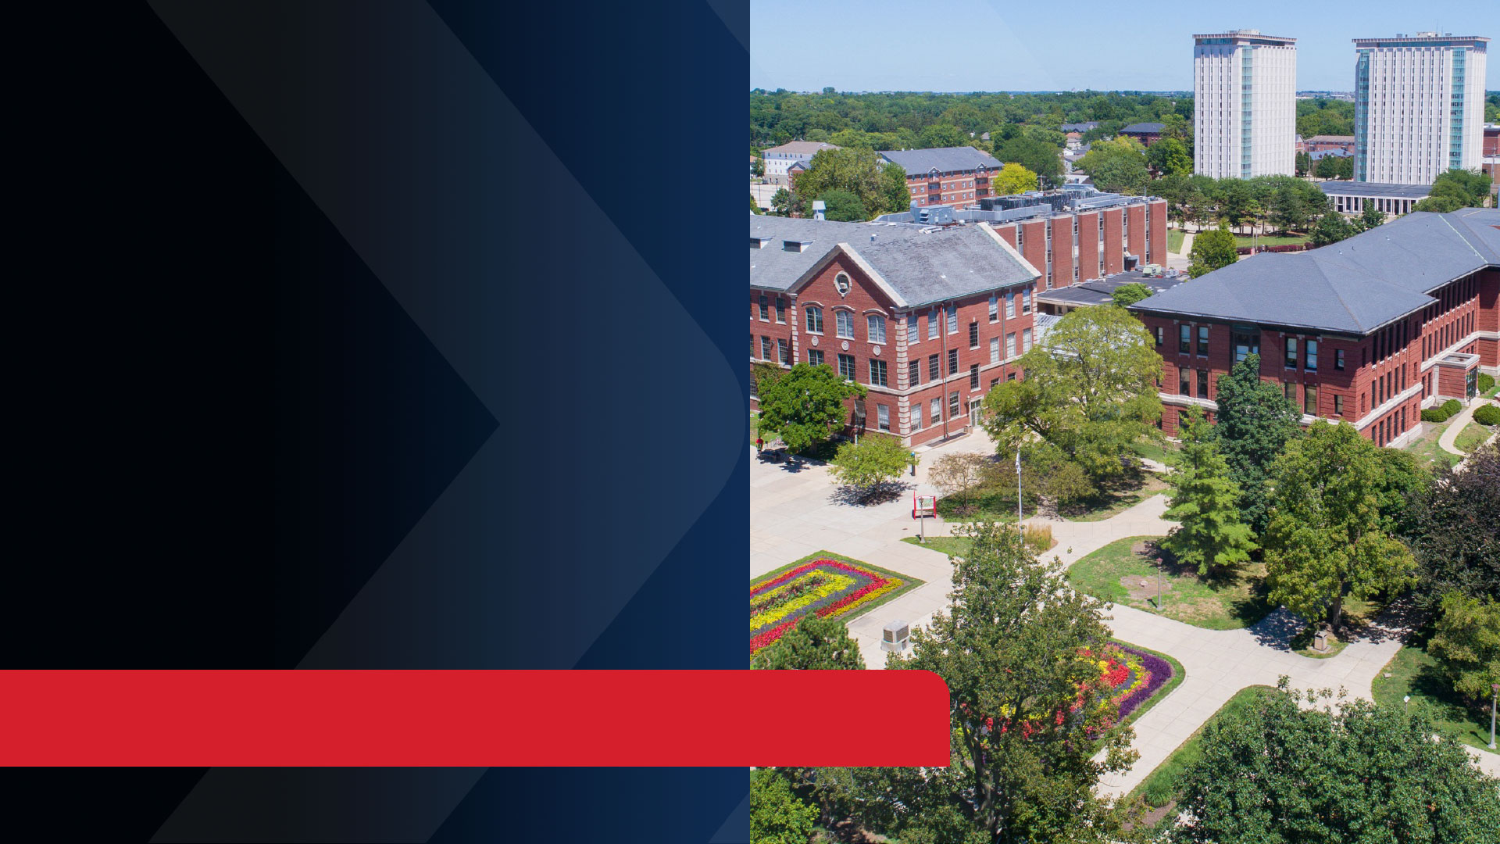

UPGRADE
YOUR FUTURE
We at Illinois State University work as a diverse community of scholars with a commitment
to fostering a small-college atmosphere with large-university opportunities.

Slide 27

Why Illinois State University?
Top 1% Most Affordable University
for International Students
Niche.com 2023
Illinois is the 4th state in the US with
the most Fortune 500 company
corporate headquarters
Fortune.com 2023
96% of our international students continue
to OPT or higher degrees within three
months of graduation
Office of International Programs and Services 2021-2022
TOP PROGRAMS
COMPUTER SCIENCE
CREATIVE TECHNOLOGIES
BUSINESS
ACTUARIAL SCIENCE

Slide 28

#3
BEST SMALL COLLEGE
TOWNS IN AMERICA
College Values Online 2022
TOP
RANKINGS
#58
Best College for
Information Technology
Niche.com 2022
#64
TOP NATIONAL UNIVERSITY
Washington Monthly 2022
#3
Highest Paid Graduates in Computer System Networking
College Factual 2021
#4
BEST INDUSTRIAL
TECHNOLOGY SCHOOL
(PUBLIC UNIVERSITIES)
College Factual 2022

Slide 29


FIND YOUR
ENERGY
CSU degree programs are designed to bring you together with world-class faculty in a student-to-faculty ratio of just 17:1.
You'll work closely with highly-qualified faculty who are leaders in their industry.

Slide 30

Why Colorado State University?
Engineering Co-op Program:
work at least three semesters in a
position related to their major with an
employer and earn a competitive salary
89% of international undergraduates and
91% of international graduate students
secure their plans or receive a job offer
within six months of graduation
Summit Fund Investment Portfolio which allows Business majors the opportunity
to manage $250,000 in the stock market as part of a cohort​
TOP PROGRAMS
ENGINEERING
ENVIRONMENTAL SCIENCE
BIOLOGICAL SCIENCES
VETERINARY SCIENCES

Slide 31

#151
NATIONAL UNIVERSITY
U.S. News & World Report 2023
TOP
RANKINGS
#2
Veterinary Science
Program in the US
U.S. News & World Report 2023
#72
TOP PUBLIC UNIVERSITY
U.S. News & World Report 2023
#3
Best College Town to Live in Forever
College Ranker 2021
#55
IN BEST ENGINEERING
SCHOOLS
U.S. News & World Report 2023

Slide 32
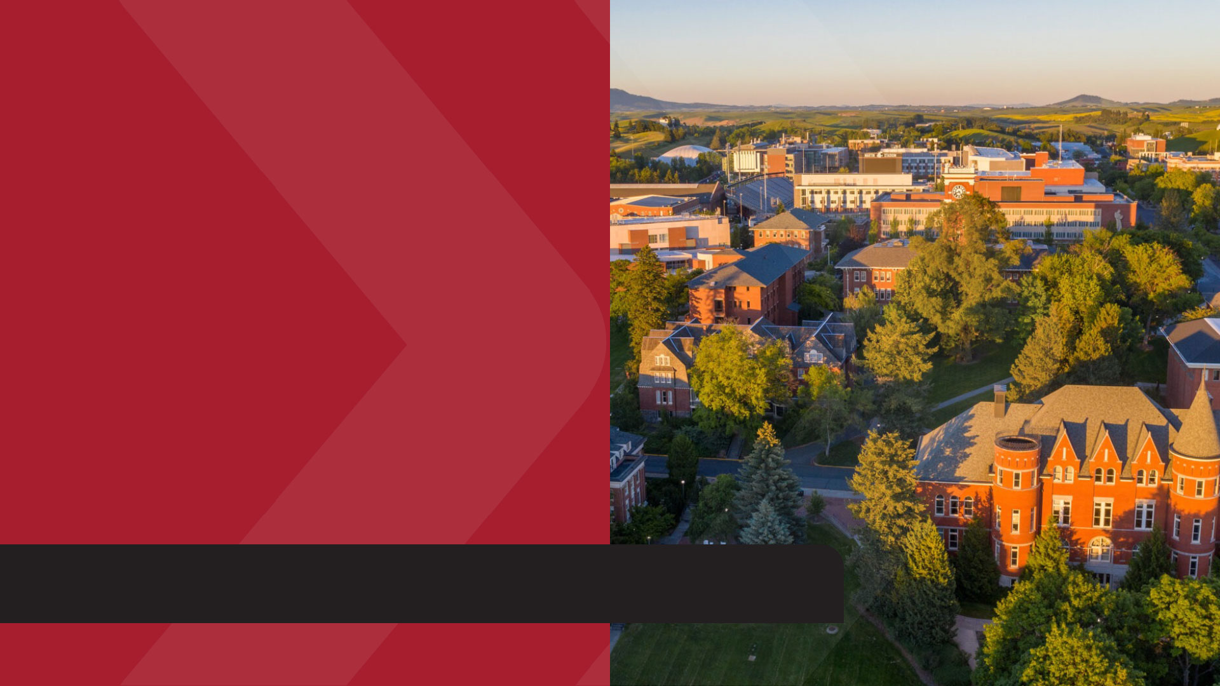

OUTSTANDING
ACADEMIC EXCELLENCE
Washington State University has earned an outstanding reputation for academic excellence, world-changing research, and a diverse, welcoming community of students, faculty and alumni.

Slide 33

Why Washington State University?
#107 Top Public Schools
U.S. News & World Report 2023
#75 Best Undergraduate Engineering Programs​
U.S. News & World Report 2023
State-of-the-art residential campus
Student experience offering dozens
of opportunities
Leading research programs
TOP PROGRAMS
COMPUTER SCIENCE
HOSPITALITY
BUSINESS
ENGINEERING

Slide 34

2023
RANKINGS
#21
International Business​
U.S. News & World Report 2023
#15
AGRICULTURAL ENGINEERING
U.S. News & World Report 2023
#8
BEST HOSPITALITY​ AND HOTEL MANAGEMENT IN THE WORLD
CEOWORLD 2023

Slide 35


ENERGY.
ENGINEERING. ENVIRONMENT.
At the University of Oklahoma, students have the space and resources to engage in cutting-edge research projects that fuel tomorrow’s defense, aerospace, climate and engineering initiatives.
With top-tier, STEM-certified programs in environmental studies, engineering and energy, OU experiences will fuel their future careers and reshape our environment.

Slide 36

Why University of Oklahoma?
#64 In Top Public Schools
U.S. News & World Report 2023
Affordable degree options
with a low cost of living.
Wide open spaces.
Wide range of opportunities.
Cutting-edge degrees in high
paying professions.
TOP PROGRAMS
PETROLEUM
MANAGEMENT INFORMATION
SYSTEMS
ENTREPRENEURSHIP
ENGINEERING: CIVIL, ENVIRONMENTAL, INDUSTRIAL, MANUFACTURING, SYSTEMS

Slide 37
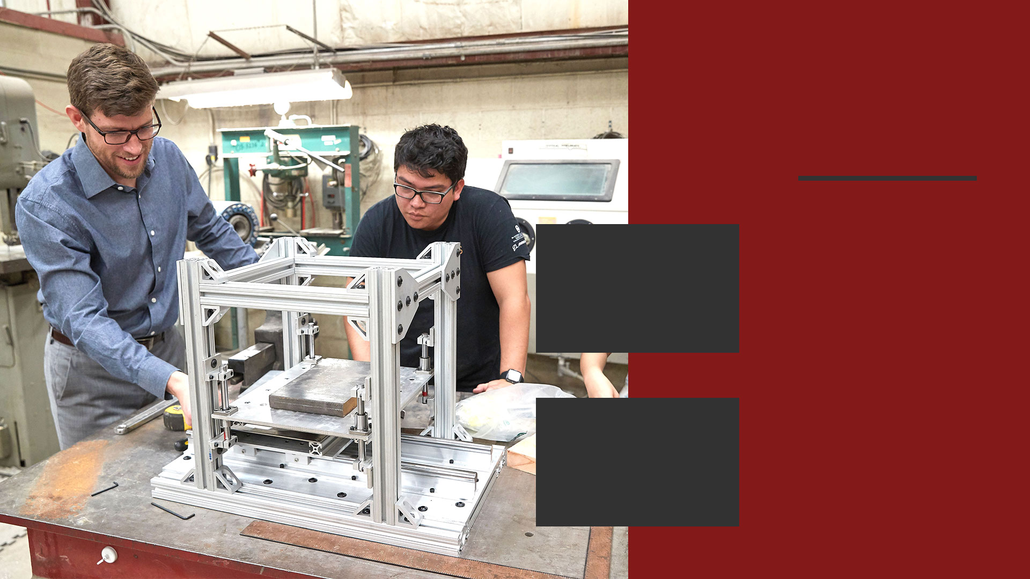
2023
RANKINGS
#113
In Geosciences (Global)
U.S. News & World Report 2023
#461
IN ENGINEERING (GLOBAL)
U.S. News & World Report 2023
#10
Colleges with Best Student Life in America
Niche 2023
#110
IN BEST ENGINEERING
SCHOOLS (TIE)
U.S. News & World Report 2023

Slide 38
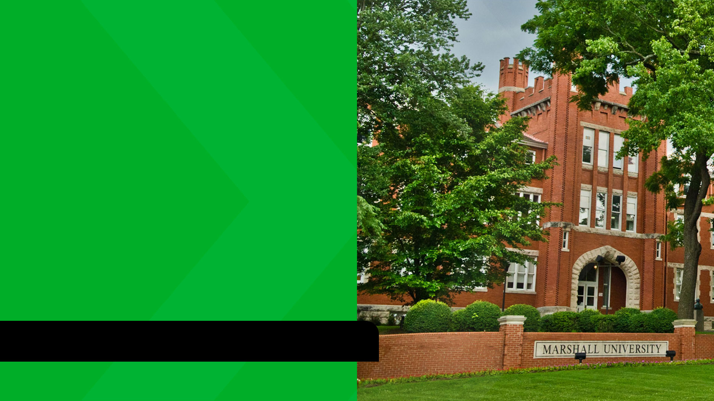

YOUR
MARSHALL
MOMENT
Marshall University is a public research university in Huntington, West Virginia with 160+ international students enrolled from more than 50 countries.
Enjoy a traditional American college campus experience and see the pride of the local community at Marshall.

Slide 39

Why Marshall University?
#4 Best Colleges in West Virginia
Best Value Schools 2024
#1 in Best College Campuses in West Virginia
Niche.com 2023
#86 in Best Undergraduate Engineering Programs
U.S. News & World Report 2024
TOP PROGRAMS
ENGINEERING
PHARMACY
PUBLIC HEALTH
BUSINESS

Slide 40

U.S. News &
World Report
2024 RANKINGS
#244
in Business Programs (TIE)
U.S. News & World Report 2024
#86
IN BEST UNDERGRADUATE ENGINEERING PROGRAMS (TIE)
U.S. News & World Report 2024
#263
in Nursing (TIE)
U.S. News & World Report 2024
#150
PUBLIC HEALTH
U.S. News & World Report 2024

Slide 41

PRIVATE Universities
“INTO Suffolk had programs that helped me prepare some basic knowledge to officially progress to the Sawyer Business School. Those classes were really helpful for me because that’s how I graduated with a high GPA. Now I have a job! I chose this place because Boston is very well-educated. We have a high education rate in the US and it’s also a very safe city for international students.”
Flora, Vietnam
MS in Business Analytics (MSBA), Class of 2021
Global business analyst for Timberland, INTO Suffolk University 2023–2024

Slide 42


SLU for
STEM
SLU is recognized for world-class academics, life-changing research, compassionate healthcare, and a strong commitment to serving local and global communities.
Earn your degree in a city highly ranked for new graduates, starting your career and lower cost of living with higher salaries.

Slide 43

Why Saint Louis University?
#105 in National Universities
U.S. News & World Report 2023
#1 City for New Graduates to Start a Career
Insurify 2022
#52 Best Value Schools
U.S. News & World Report 2023
#1 Most Affordable Metro Area
SmartAsset 2023
#1 Tech-centric City for Jobs
IT Resources 2021
Top Five City for High
Salaries/Low Cost of Living
The Ascent 2021
TOP PROGRAMS
ENGINEERING: COMPUTER SCIENCE,
ARTIFICIAL INTELLIGENCE, SOFTWARE
ENGINEERING, INFORMATION SYSTEMS
GRADUATE BUSINESS:
PROFESSIONAL MBA AND ONE-YEAR MBA
UNDERGRADUATE BUSINESS
GRADUATE HEALTH:
HEALTH DATA SCIENCE, PUBLIC HEALTH
UNDERGRADUATE HEALTH/PRE-MEDICAL

Slide 44

GRADUATE
U.S. News &
World Report
2023 RANKINGS
#1
HEALTH LAW
#11
INTERNATIONAL
BUSINESS
UNDERGRADUATE
#17
Entrepreneurship
#12
ENTREPRENEURSHIP
#17
International Business
#44
Finance
#20
SUPPLY CHAIN
MANAGEMENT

Slide 45

SLU
MADRID
16 fully accredited
undergraduate and two
graduate degrees can be
completed entirely in Madrid, Spain.
Students can choose from among
more than 40 degree programs to
start at SLU-Madrid and finish in the
US at SLU's campus in St. Louis.

Slide 46
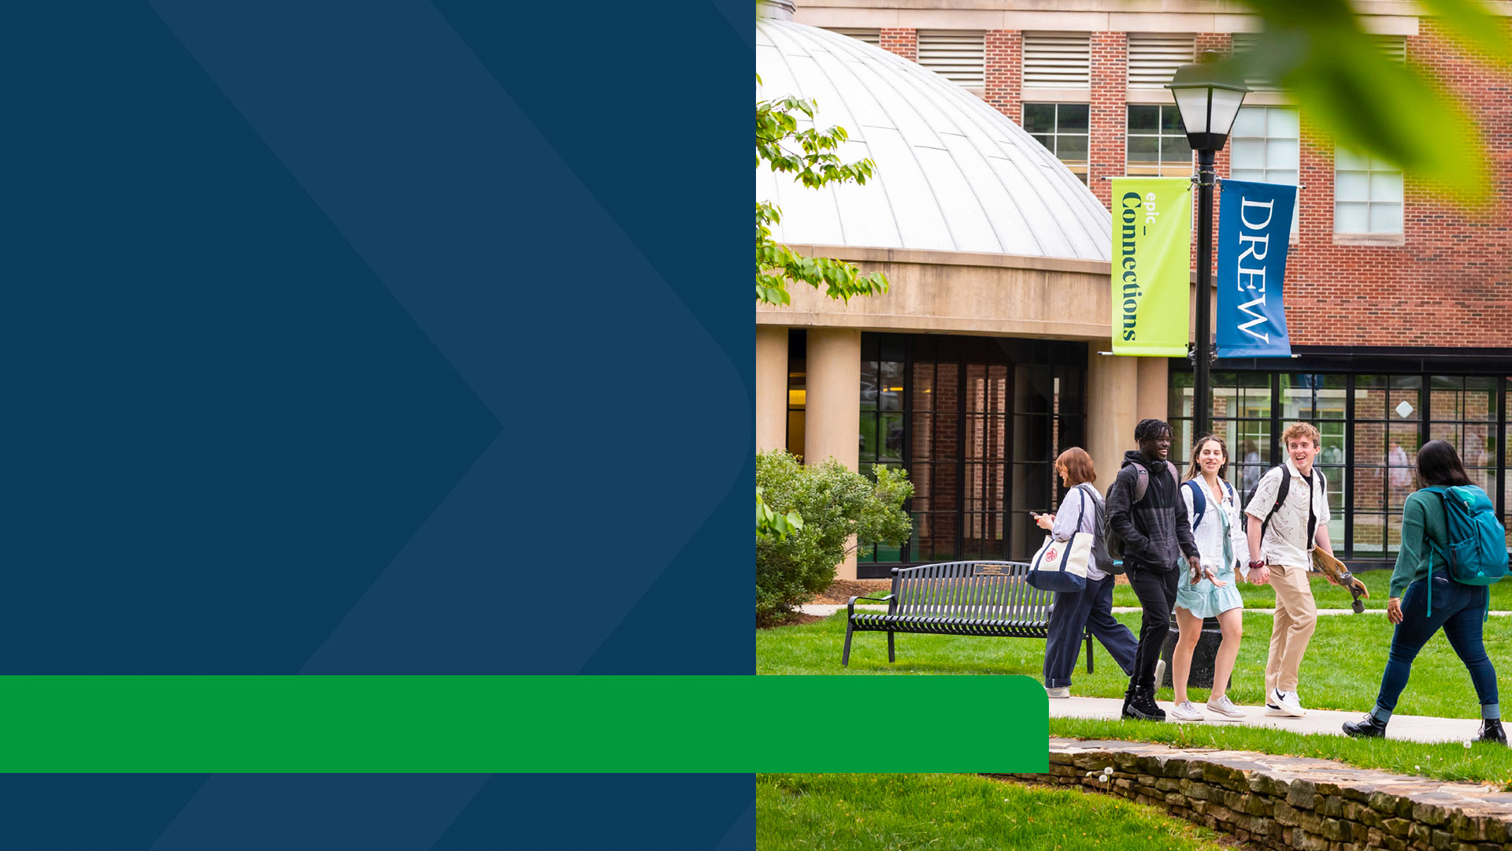

GATEWAY TO
GLOBAL CAREERS
Drew is fourth nationally in enrolling international students among baccalaureate colleges. Drew offers thousands of internship opportunities at major employers such as Goldman Sachs, Google, Sony Music, The Metropolitan Museum of Art and CNN.
Our New York City semesters and our Dual-Degree programs with Columbia University transform our students into competitive alumni in the job market.

Slide 47

Why Drew University?
A Drew University education has more than
a $1.1M return on investment over a 40
year period, which ranks us in the top 10%
for all US colleges
Georgetown University's Center on Education and the Workforce 2022
Top 10 Best Colleges for Networking
College Magazine 2023
NYC Semesters: Wall Street, United Nations,
Contemporary Art, Communications and
Media, Museums and Cultural Management,
New York Theatre and Social Impact
Less than an hour train ride to New York City
TOP PROGRAMS
MS in FINANCE
MS in DATA SCIENCE
BS in BUSINESS
BS in NATURAL SCIENCES (NEUROSCIENCE)
BS in COMPUTER SCIENCE
BS in MATHEMATICS

Slide 48

FAST FACTS
70%
of classes have fewer
than 20 students
99%
OF FACULTY HOLD THE HIGHEST DEGREE IN THEIR FIELD
#11
in the Nation for Enrolling
International Students
Institute of International
Education
  Open Doors Report 2022
90% OF RECENT GRADUATES WERE EMPLOYED OR IN GRADUATE SCHOOL WITHIN SIX MONTHS OF GRADUATION

Slide 49


NEW YORK’S MOST
CAREER-INTENSIVE UNIVERSITY
Hofstra provides students with an industry-led education combined with faculty actively engaged in the field. Get the most out of intimate learning environment with all the resources of a large university.
Enhance your program with our state-of-the-art facilities like Bloomberg terminals for business/finance, studio space for film/communication and engineering co-op for working and connecting with top companies.

Slide 50

Why Hofstra University?
13:1 student-to-faculty ratio/average
for undergraduate
93% of graduates are employed or
attending graduate school
Undergraduate & Graduate Alumni Outcomes 2021-2022
45 minutes by train or one hour by car
to New York City
Top 16% For Return On Investment
And Best Value
PayScale College ROI Report 2022
TOP PROGRAMS
BUSINESS and MBA
COMPUTER SCIENCE
ENGINEERING
HEALTH PROFESSIONS:
HEALTH INFORMATICS, PUBLIC HEALTH

Slide 51
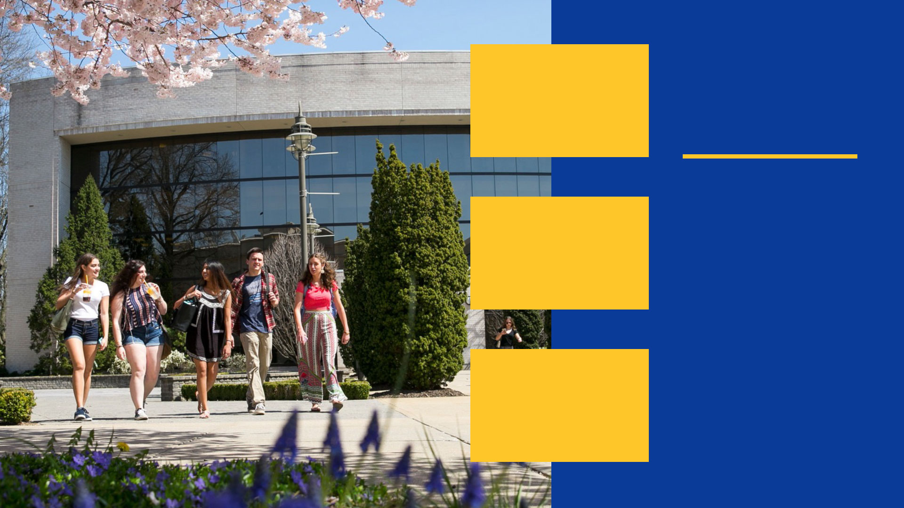
#118
BEST VALUE SCHOOLS
U.S. News & World Report 2023
TOP RANKINGS
and STATISTICS
100%
of Hofstra computer science graduates have jobs and/or are in grad school within six months
Class of 2020-2021
#29
BEST UNDERGRADUATE ENGINEERING PROGRAMS
U.S. News & World Report 2023
#22
Most Popular Master’s Degree Colleges for Finance and Financial Management
College Factual 2022
TOP 3%
of the nation’s Best Schools for Business Majors (for graduates with a bachelor’s degree)
PayScale College Salary
Report 2021-2022

Slide 52


BOSTON MEANS
BUSINESS
At Suffolk University in downtown Boston, you'll find opportunities to expand your studies and open your world around every corner. You'll gain new insights in our classrooms and experience your education through internships and hands-on learning.
What you learn here will power your success for years to come.

Slide 53

Why Suffolk University?
#1 Best Student City in North America
QS Top Universities Rankings 2024
Sawyer Business School is the only US
business school to be simultaneously
accredited by AACSB, NASPAA, and CAHME
for its graduate business, public
administration and healthcare programs.
2023 Best Business Schools
The Princeton Review 2023
Sawyer Business School MBA Ranked
Tier 1 – 7th year in a row
CEO Magazine, 2023 Global MBA Rankings
Suffolk Law is the only law school ranked in
the top 20% of all skills specialty areas—legal
writing, clinics, trial advocacy, and dispute
resolution--for seven years running.
U.S. News & World Report Best Law Schools
2017-2023 editions
TOP PROGRAMS
BS/BA in BUSINESS
MS in BUSINESS ANALYTICS
MA in COMMUNICATION
MA in FINANCE
LAW: LLM

Slide 54

U.S. News &
World Report
2023 RANKINGS
#135
in Best Business Schools in the US
#11
MOST INTERNATIONAL STUDENTS IN THE US
#249
Best Colleges in the US
#1
STATE WITH THE BEST
BUSINESS ENVIRONMENT

Slide 55


WHERE
CREATIVITY
STEMs
We are a university that focuses on learning across subjects and professional experiences to inform your education.
We deliver exceptional value for 21st century students with excellence in architecture, business, design, engineering, fashion and textiles, health, science and social science.

Slide 56

Why Thomas Jefferson University?
Nexus Learning: Students gain a competitive edge on the job market by earning and education that blends theory and hands-on learning. Students work in collaboration with a variety of programs and gain real-life experience.
98.5% College of architecture accepted employment,
graduate school or gap year
Class of 2021 First Destination Report
97% Success rate among undergraduate students in
securing jobs or going on to graduate school
(among the highest success rates out there)
Class of 2021 First Destination Report
Philadelphia has the 6th largest workforce in the US
located in the 2nd largest city on the East Coast
97% Kanbar College graduates accepted
employment or graduate school
Class of 2021 First Destination Report
Philadelphia is one of the trendiest and most
affordable cities in the US for 2022
Realtor.com 2022
TOP PROGRAMS
CONSTRUCTION MANAGEMENT
MS in UX and INTERACTION DESIGN
MS in PHARMACEUTICAL SCIENCES
MS in ARCHITECTURE

Slide 57
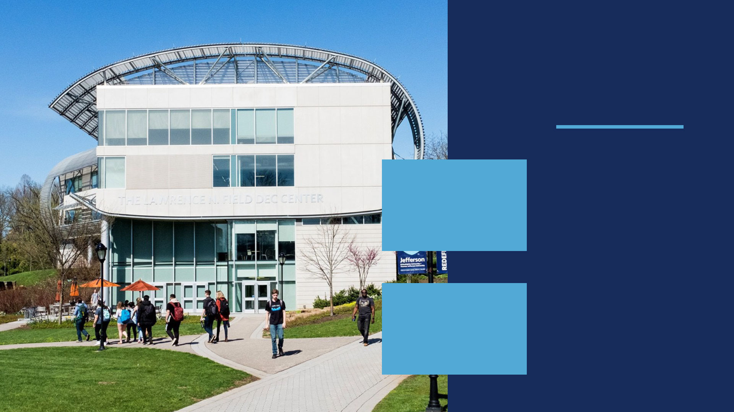
TOP
RANKINGS
Top 10 Honors in
Design Intelligence
(Interior Design, Interior
Architecture, Architecture)
DesignIntelligence 2019​
#127
NATIONAL UNIVERSITIES
U.S. News & World Report 2023
#61
BEST VALUE SCHOOLS
U.S. News & World Report 2023

Slide 58

IN THE HEART OF
NEW ENGLAND
NEC offers more than 60 associate and bachelor’s degree programs, more than 20 master’s degree programs and a doctoral program, all delivered by dedicated and accomplished faculty.
Learn from the liberal arts tradition with an emphasis on experiential learning.

Slide 59

Why New England College?
Student to teacher ratio: 14-1​
14% of on-campus students are international
1,200 Undergraduate
on-campus students
100% OPT approval rate​
14% of on-campus students
are international​
90 minutes from Boston, for career
and networking opportunities
TOP PROGRAMS
MBA
MS in DATA SCIENCE
and ANALYTICS
MS in HEALTH
INFORMATICS

Slide 60
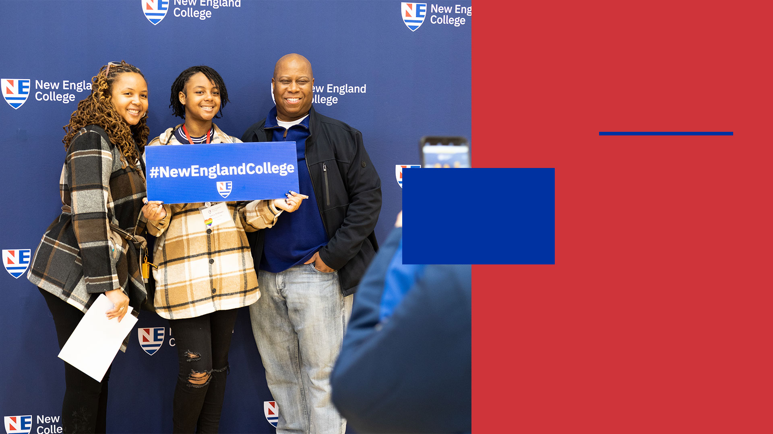
U.S. News &
World Report
2023 RANKINGS
TOP 200
REGIONAL
UNIVERSITIES NORTH
#164
IN TOP PERFORMERS
ON SOCIAL MOBILITY

Slide 61


A DOORWAY TO BOSTON,
A BRIDGE TO THE WORLD
Small class sizes, personalized attention, dedicated professors and a world of experiences both
inside and outside the classroom make Fisher College the perfect place to earn your degree.

Slide 62

Why Fisher University?
43 Countries represented;
10% international students
95% of students employed or in an
advanced degree program within a year
of graduation
Guest speakers and masterclasses from
CBS Radio, Nordstrom, small business
owners, and other amazing industries
in the Boston area​
Located in the heart of Boston
TOP PROGRAMS
BS in MANAGEMENT
MBA

Slide 63
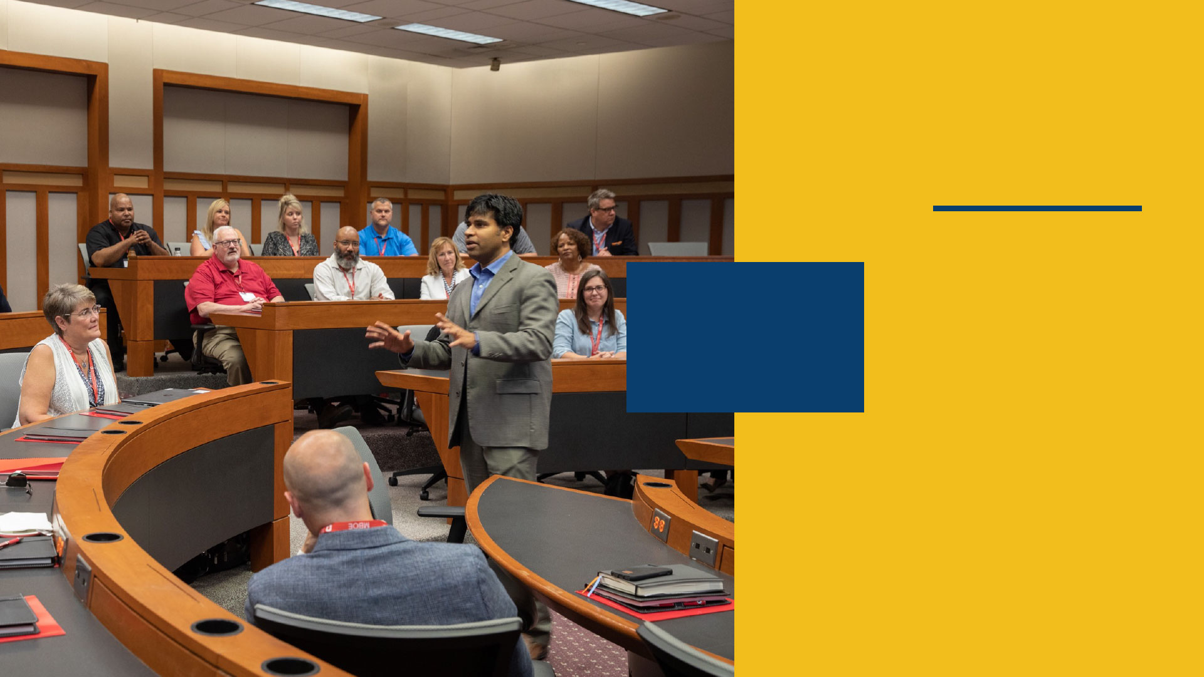
2023
RANKINGS
#8
TOP PERFORMER ON
SOCIAL MOBILITY
U.S. News & World Report 2023
#24
Best College Locations
in America
Niche 2023

Slide 64

YOUR BRIDGE
TO EXCEPTIONAL
EDUCATION
Recognized by Forbes for its emphasis on experiential learning and by the Brookings Institution for its “value added” to student outcomes.
LIU offers 220+ degree programs, with a network of over 285,000 alumni that includes industry leaders and entrepreneurs across the globe.

Slide 65

Why Long Island University?
LIU POST
Student to teacher ratio: 11-1
The Post Theatre Company has
won 20 Kennedy Center American College
Theatre Awards
College of Management is accredited by
AACSB International, a distinction achieved
by only 5% of the world’s business schools​
LIU BROOKLYN
Student to teacher ratio: 11-1​
Located in Downtown Brooklyn – one of
the fastest growing economic and cultural
neighborhoods​
Internships opportunities with top
companies throughout the New York City area
Home to the RocNation School of Music,
Sports and Entertainment
Brooklyn's only Pharmacy School

Slide 66
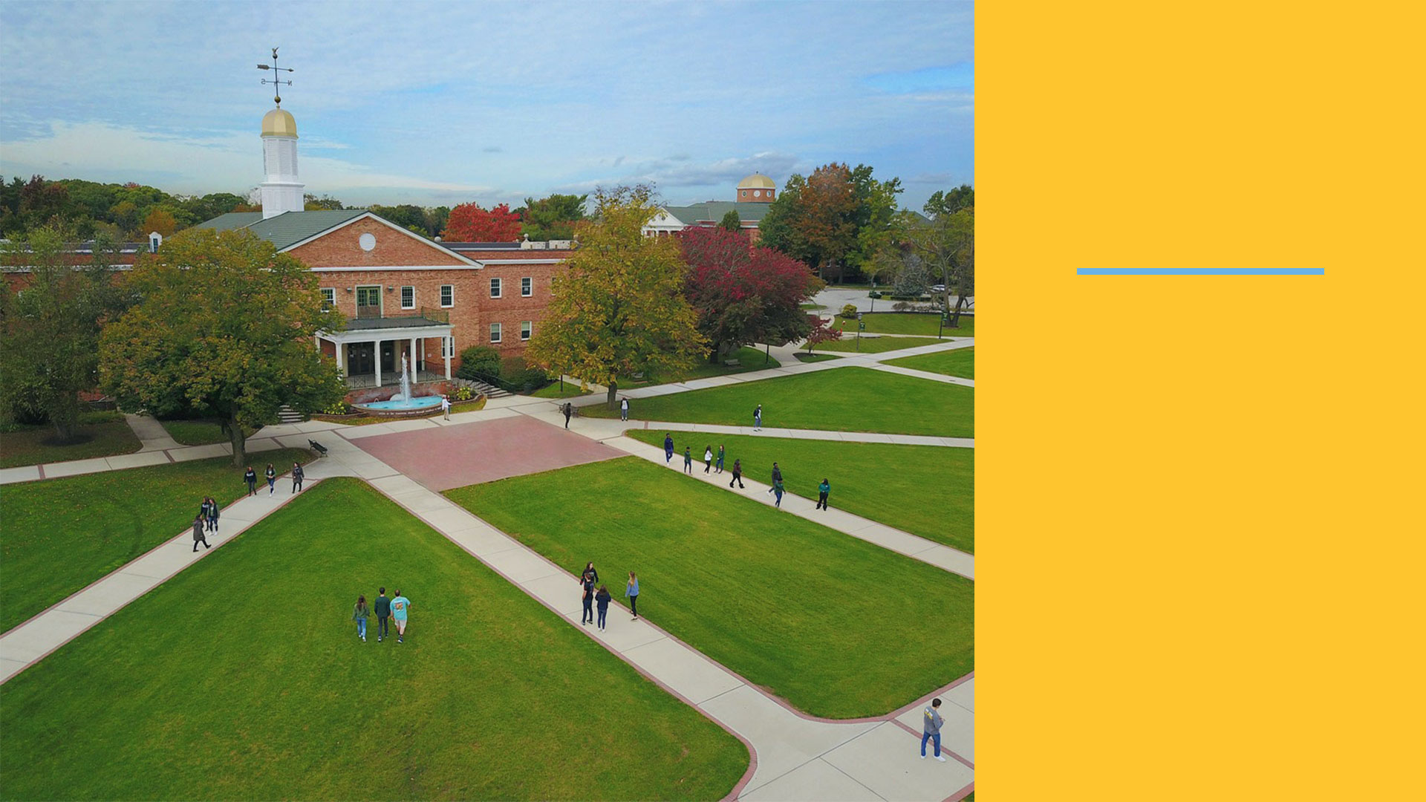
TOP
PROGRAMS
PHARMACY/PHARM D
PUBLIC HEALTH
BUSINESS
ARTS
ENTERTAINMENT
MUSIC

Slide 67

 | First Year Admission |  |  | Transfer Admission |  | Graduate Admission
 | Undergraduate Direct Entry | International Direct | International Year One | Transfer Direct Entry | Undergraduate Transfer Program | Graduate Direct Entry | Integrated Master's Program | Master’s International Direct | Graduate Pathway
Oregon State University | X | X | X | X | X | X |  | X | X
George Mason University | X | X | X | X | X | X |  |  | X
Mason Korea | X
Montclair State University | X |  |  |  |  | X
University of Oklahoma | X |  |  |  |  | X
The University of Alabama at Birmingham | X | X | X | X | X | X | X |  | X
Illinois State University | X |  | X | X | X | X |  |  | X
University of Arizona | X |  |  | X |  | X
University of Massachusetts, Amherst |  |  |  |  |  | X
Colorado State University | X |  |  | X |  | X
Washington State University | X |  |  | X |  | X
Saint Louis University | X |  | X | X | X | X |  |  | X
SLU Madrid | X
Drew University | X |  | X | X | X | X | X |  | X
Suffolk University | X | X | X | X | X | X | X
Hofstra University | X | X | X | X | X | X | X |  | X
Thomas Jefferson University | X |  |  | X |  | X
Long Island University | X |  |  | X |  | X
New England College | X |  |  | X |  | X
Fisher College | X |  |  | X |  | X
Marshall University | X |  |  |  |  | X
ADMISSION ROUTES AT OUR US UNIVERSITY PARTNERS

Slide 68

HOW
To Apply (AGENTS)
ARE YOU AN EDUCATION COUNSELOR?
Visit our portal for exclusive access to all the information you need to counsel students, and submit and track your applications, all in one place: partnerportal.intoglobal.com
You can submit multiple applications to both pathway and direct entry university partners in a single online form.

Slide 69





FIND OUT MORE
Discover more online
Visit our website to discover the study abroad options available to you: intostudy.com
    www.facebook.com/INTOstudy
    www.Instagram.com/intostudy
    www.myin.to/INTO_YouTube
    blog.intostudy.com

Slide 70

Intoglobal.com

